Slide 1
Evolution of Bharatavarsha / Terms associated with the geography of the Indian subcontinent
INDIAN KNOWLEDGE
SYSTEMS

Slide 2
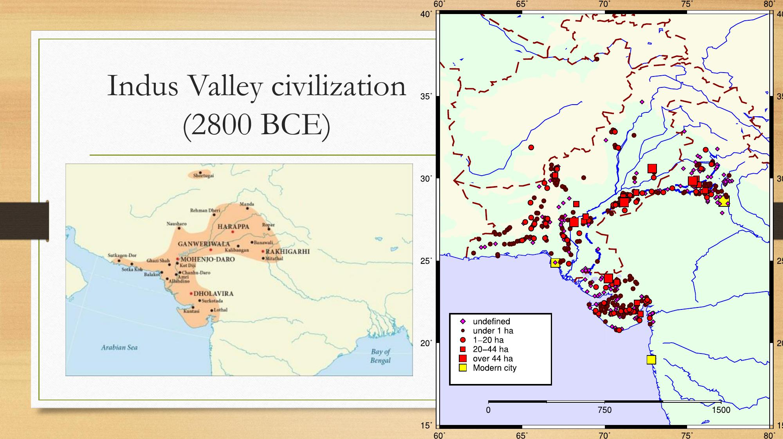

Slide 3
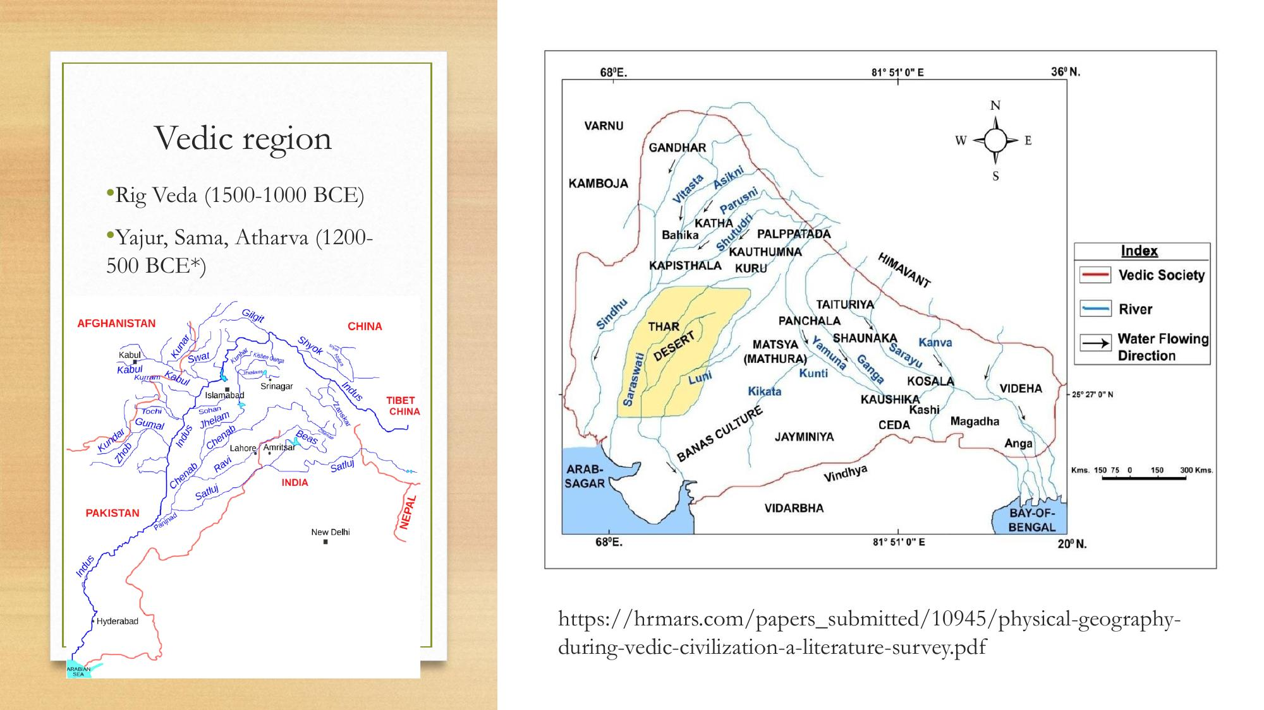

Slide 4
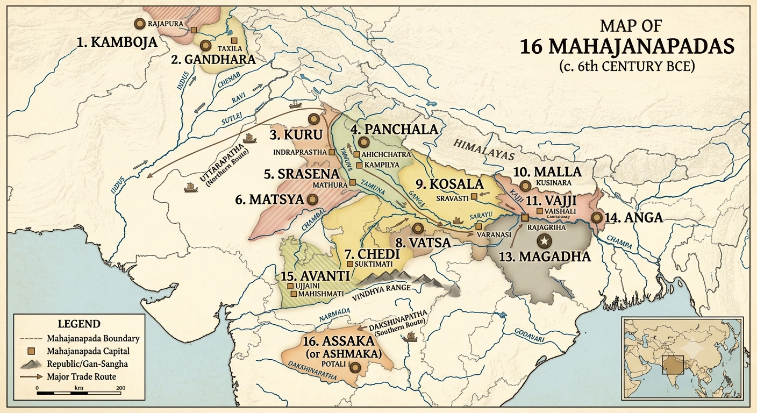

Slide 5
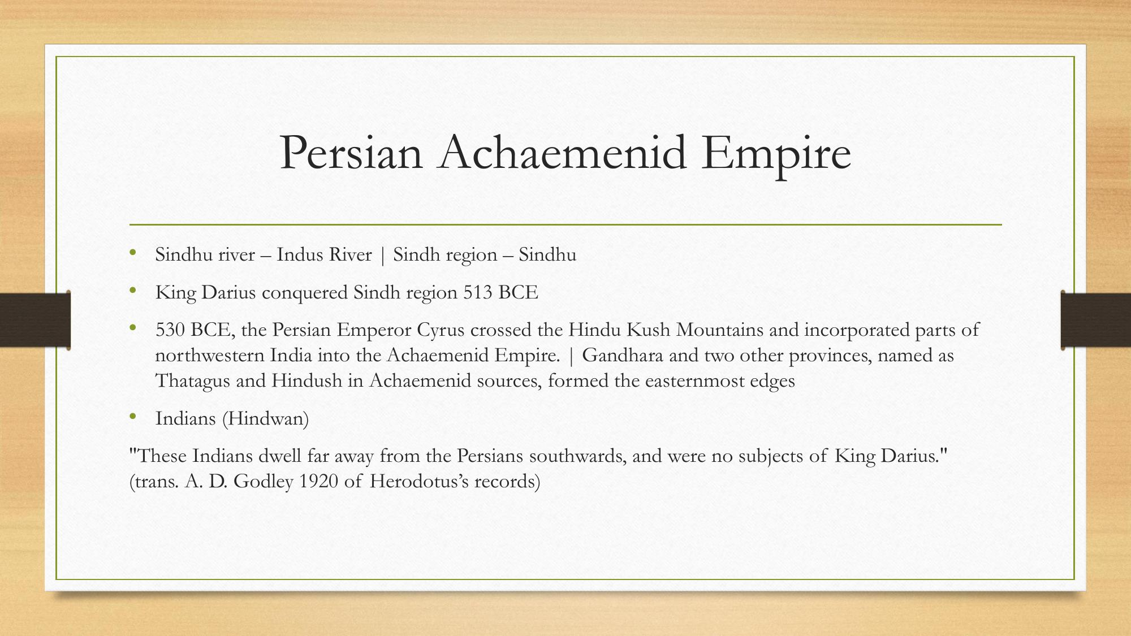

Slide 6
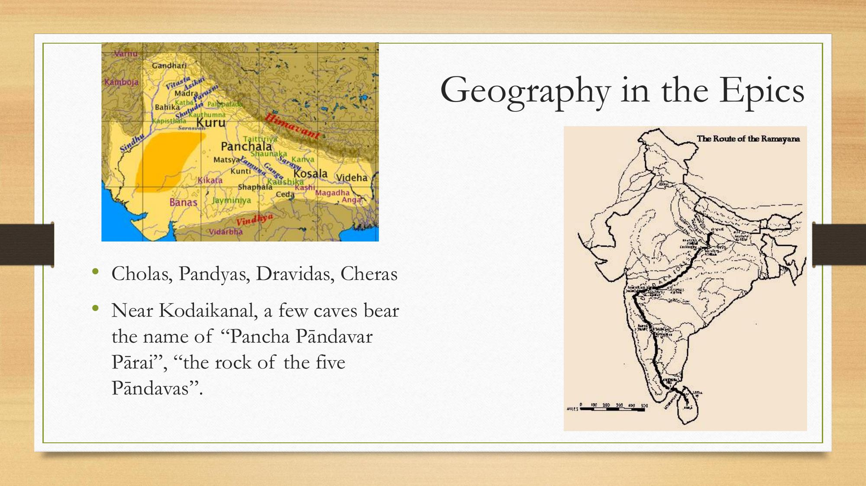

Slide 7
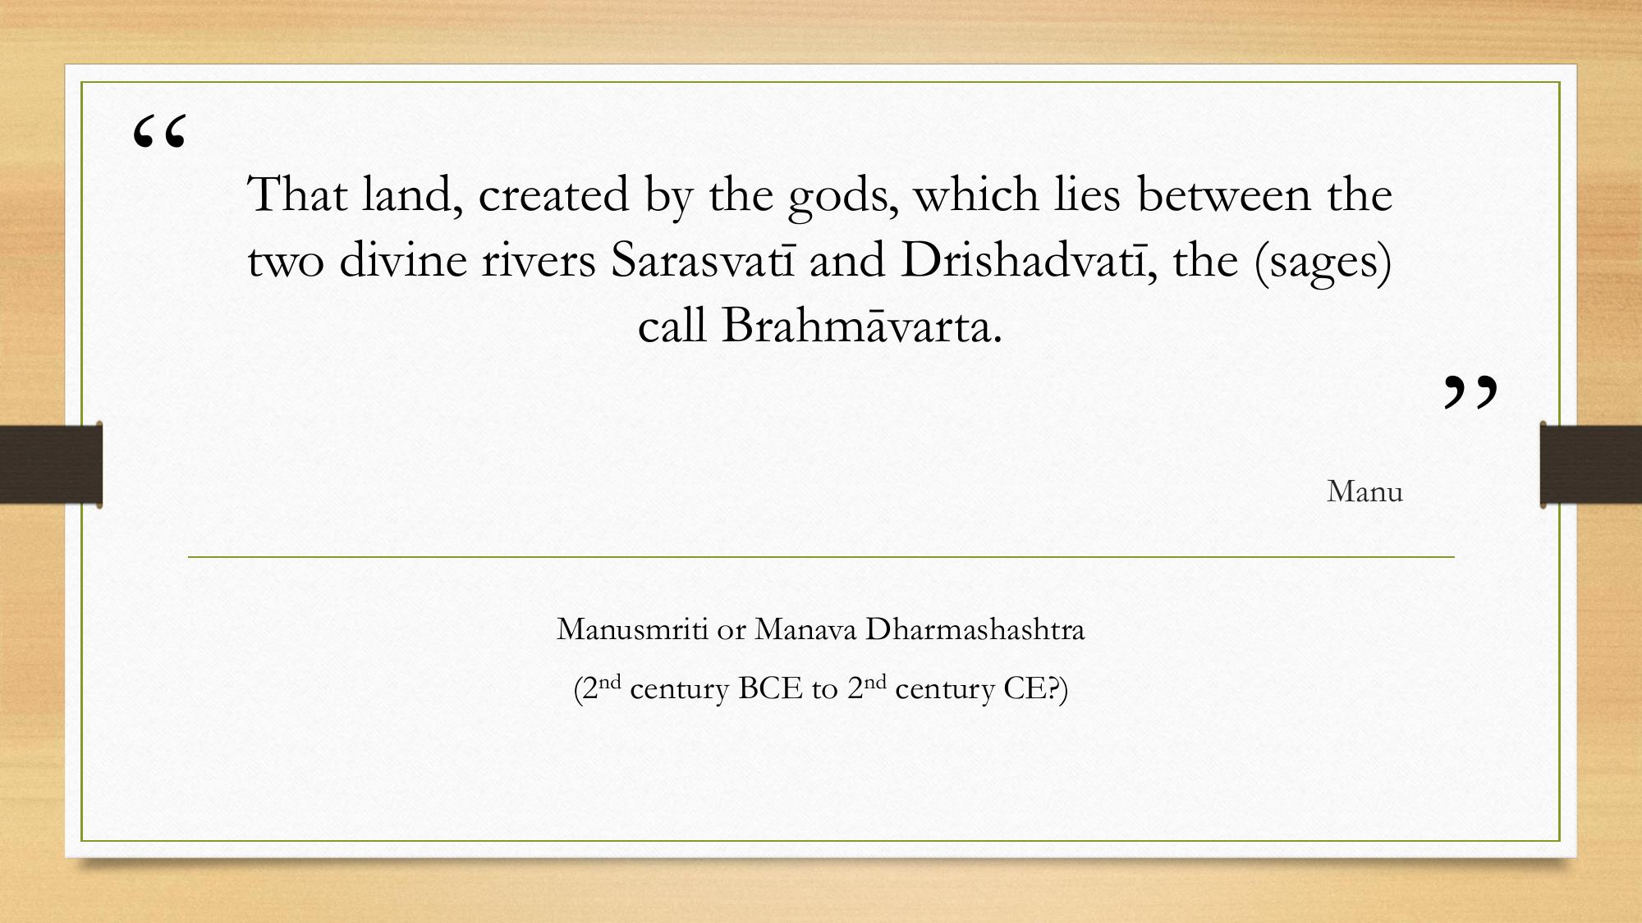

Slide 8
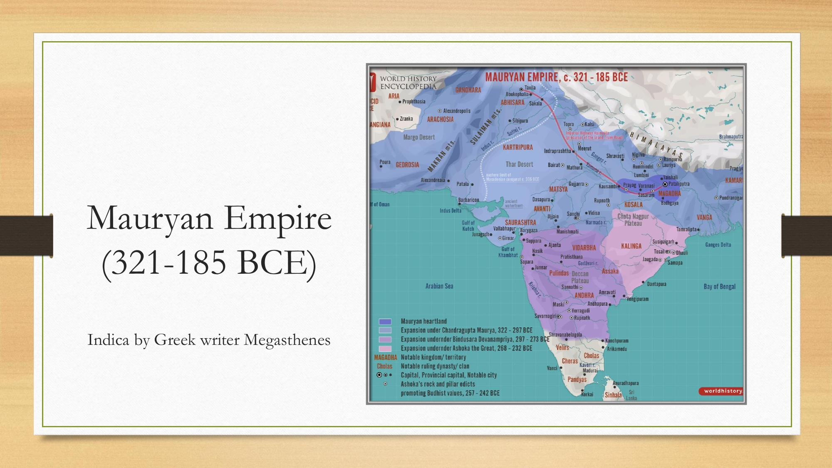

Slide 9
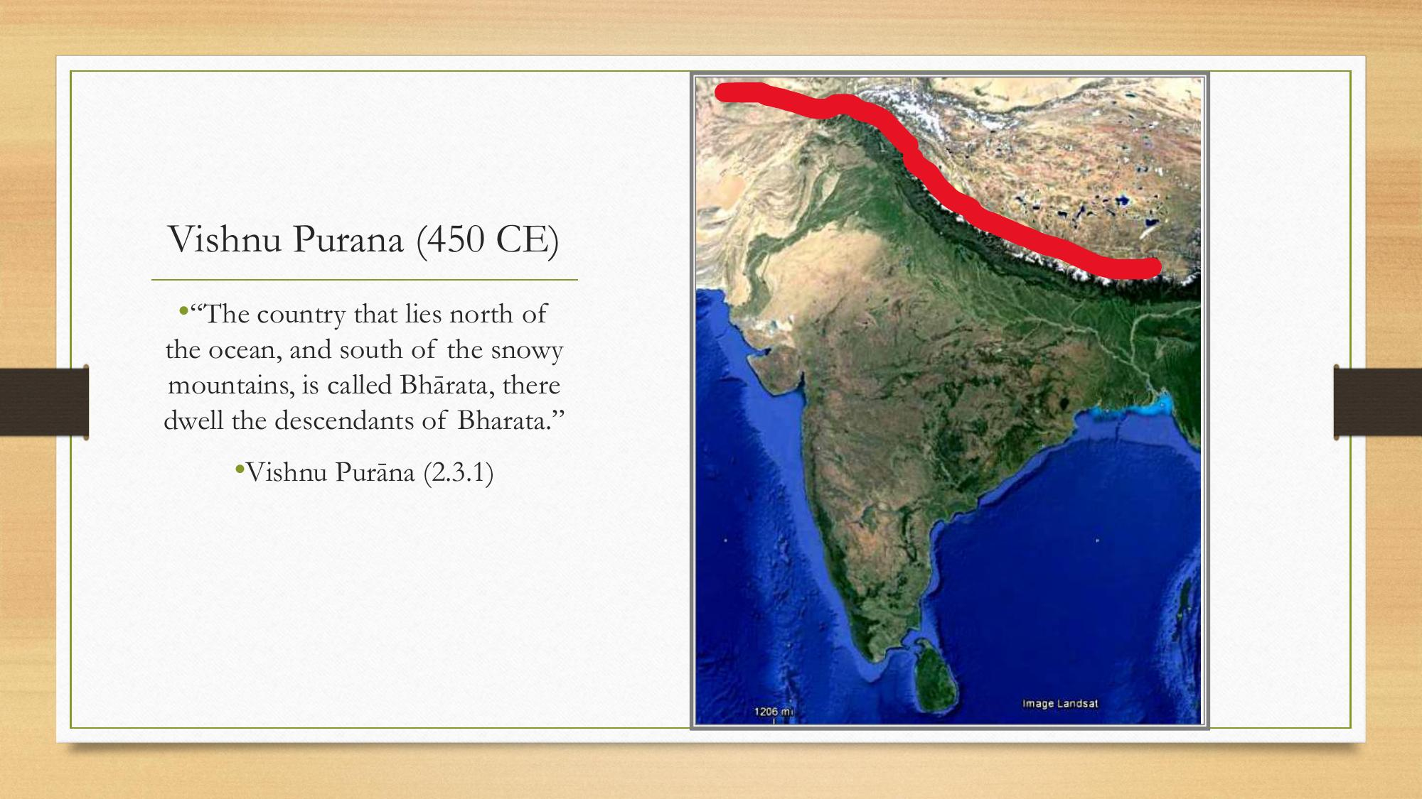

Slide 10
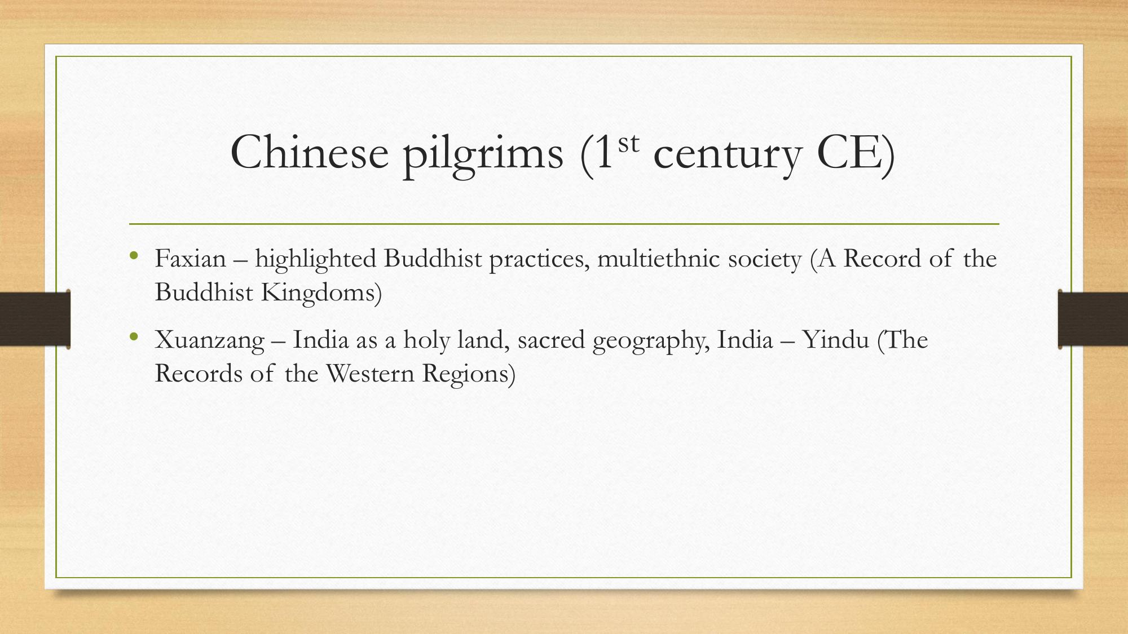

Slide 11
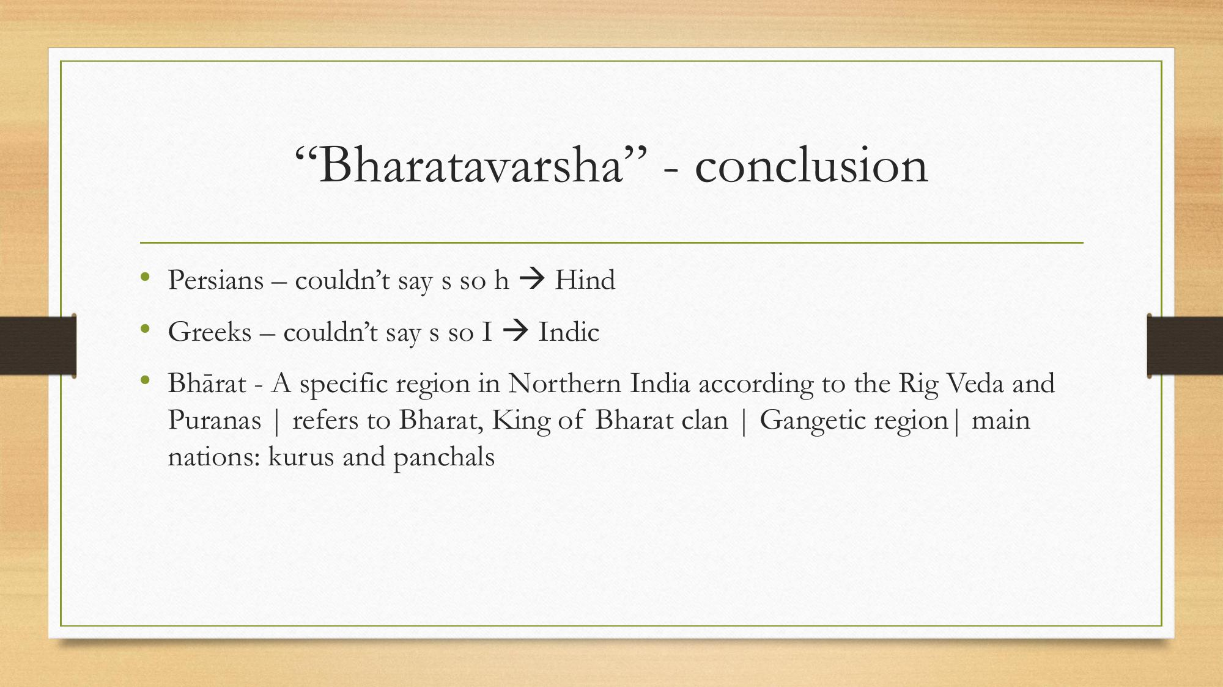

Slide 12
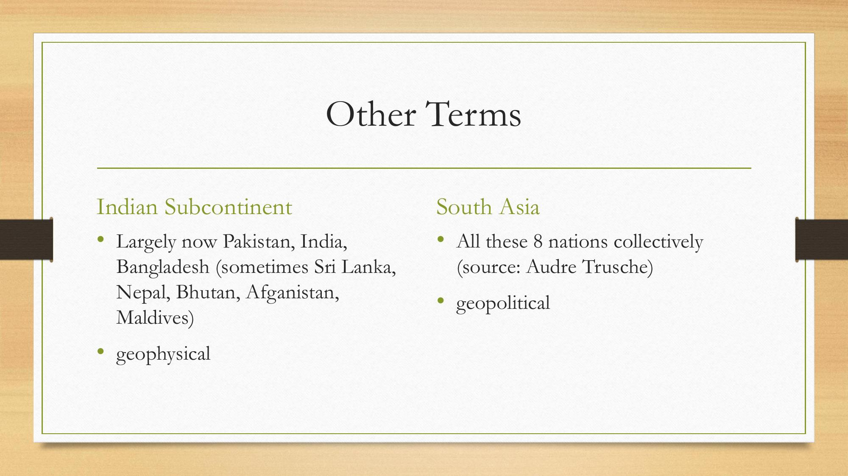

Slide 13
Rise of Nationalism in India
During World War I
1914 – 1919

Slide 14
India and the Great War
Over 1.3 million Indian troops and labourers served overseas in WWI (1914–1918)
India supplied grain, raw materials, and finances to support the British war effort
Indian leaders expected greater self-governance in return for wartime loyalty
Rising prices, wartime taxation, and food shortages fuelled discontent at home

Slide 15
The Home Rule Movement (1916)
Bal Gangadhar Tilak launched the Indian Home Rule League in April 1916
Annie Besant founded a parallel Home Rule League in September 1916
Demanded home rule (self-government) for India within the British Empire
“Swaraj is my birthright, and I shall have it” – Tilak
Spread nationalist sentiment beyond elite circles into towns and districts

Slide 16
The Lucknow Pact (1916)
Indian National Congress and the All-India Muslim League came together at Lucknow
Agreed on a joint scheme of constitutional reforms and separate electorates
Marked a rare moment of Hindu–Muslim political unity against colonial rule
Tilak, Besant, and Jinnah were key figures in negotiating the pact

Slide 17
Montagu Declaration & Rowlatt Act (1917–19)
1917: Secretary of State Montagu promised “responsible government” by stages
Montford Reforms (1919) fell far short of nationalist expectations
Rowlatt Act (1919) allowed detention without trial, curbing civil liberties
Widely condemned as the “Black Act”; sparked hartals and mass protest

Slide 18
Jallianwala Bagh Massacre (1919)
13 April 1919: British troops under General Dyer fired on an unarmed crowd in Amritsar
Hundreds killed and many more wounded at the enclosed Jallianwala Bagh garden
Provoked nationwide outrage and discrediting of British claims to just rule
Rabindranath Tagore renounced his knighthood in protest

Slide 19
Khilafat & Non-Cooperation (1919–20)
Khilafat Movement: Indian Muslims protested the treatment of the Ottoman Caliph after WWI
Gandhi united the Khilafat cause with the nationalist movement
1920: Indian National Congress launched the Non-Cooperation Movement
Mass, countrywide participation transformed nationalism into a popular struggle
Set the stage for the mass movements of the 1920s and beyond

Slide 20
